Slide 1

Large language models for sentiment analysis
Student Name: Thelma Munyuki
Registration Number:R204582G
Supervisor: Mr Njera
Degree Programme: Data Science and Informatics

Slide 2
Introduction and Background
Sentiment analysis, also known as opinion mining, is a vital technique in the field of natural language processing that focuses on understanding and classifying the sentiment or emotional tone expressed in textual data. It plays a crucial role in various domains, including market research, social media monitoring, customer feedback analysis, reputation management, and brand perception[1].
With the advent of large language models (LLMs) like BERT and RoBERTa, there is a significant opportunity to enhance the capabilities of sentiment analysis. LLMs are advanced artificial intelligence models that have been trained on vast amounts of text data, enabling them to understand and generate human-like language. These models possess a deep contextual understanding of language, making them well-suited for sentiment analysis tasks[2].
The rise of e-commerce and online platforms has led to an abundance of customer reviews, providing valuable insights into product perception and customer satisfaction. However, manually analysing large volumes of reviews can be time-consuming and subjective. This project aims to address this challenge by developing an ensemble model based on BERT (Bidirectional Encoder Representations from Transformers) and RoBERTa (Robustly Optimized BERT Pretraining Approach) for automated sentiment analysis of customer reviews. By combining the strengths of these two large language models, the ensemble model is expected to achieve good accuracy and robustness in identifying the sentiment (positive, negative, or neutral) expressed in customer reviews.

Slide 3
Problem Statement
Despite the advancements in sentiment analysis techniques, there are still challenges in accurately analysing sentiment in textual data. Traditional methods often struggle with understanding context, sarcasm, and domain-specific language. This study aims to address these challenges by utilizing large language models, which have the potential to capture intricate nuances of language and improve sentiment analysis accuracy.

Slide 4
Gap
While traditional machine learning approaches can classify sentiment with some success, they have difficulty with more complex data, like sarcasm and irony.
large language models address these limitations by , firstly they can use context to understand the meaning of a piece of text. They can look at the words before and after a given word to get a better understanding of its meaning. Secondly, they can learn from unstructured data, like text, instead of just structured data, like numbers. This allows them to understand more complex language patterns. Thirdly, they can learn on their own, without being programmed for specific tasks.
This project aims to combine BERT with RoBERTa using stacking ensemble approach for sentiment analysis on customer review dataset.

Slide 5
Research Question(s)
How can the capabilities of sentiment analysis be enhanced using large language models (LLMs) like BERT and RoBERTa?
What are the advantages of using an ensemble model based on BERT and RoBERTa for automated sentiment analysis of customer reviews?
How does the ensemble model compare to individual models (BERT and RoBERTa) in terms of accuracy and robustness in identifying sentiment in customer reviews?

Slide 6
Research Objectives
To develop an ensemble model that combines the strengths of BERT and RoBERTa for improved sentiment analysis accuracy.
To evaluate the performance of the ensemble model in terms of accuracy, robustness, and efficiency compared to individual models.

Slide 7
Literature Review
Many studies have been conducted on sentiment analysis using large language models , machine learning algorithms and deep learning models . On many research papers large language models has performed well.
Looking on my base paper the author said sentiment analysis is a natural language processing (NLP) technique that identifies the attitude or opinion of a writer in a text[10]. It is a widely used technique in social media analysis, customer service, and marketing. Traditional sentiment analysis methods use bag-of-words (BoW) or word embedding models. However, these methods have limitations in capturing the context of words and sentences. BERT is a transformer-based language model that has been shown to achieve state-of-the-art results on a variety of NLP tasks, including sentiment analysis. BERT models are pre-trained on a massive dataset of text and code, which allows them to learn the contextual meaning of words. The authors discussed the use of BERT for sentiment analysis in Twitter. The authors proposed a method that combines BERT with convolutional neural networks (CNNs), recurrent neural networks (RNNs), and bidirectional long short-term memory (BiLSTMs) to achieve state-of-the-art results on a variety of sentiment analysis tasks.
The authors [10]combined BERT with deep learning classifiers, which gives their model better performance than using machine learning classifiers alone. They used a dynamic vector generation method that considers the context of words in a sentence. [10]experiments showed that their approach achieves an accuracy of 93% and F-measure of 95% on a sentiment analysis task on Twitter data. This is a significant improvement over previous studies, which have achieved accuracies of around 80%. The authors[10] concluded that their approach is a promising new method for sentiment analysis on Twitter. They suggested that future work could explore the use of BERT for sentiment analysis on other social media platforms and on text data that is not sourced online.
Therefor my research project is going to focus on combining two large language models BERT and RoBERTa using ensemble approach as they have shown to achieve best accuracy in previous studies .

Slide 8
year | Author | Models | Results | Research gap
2023 | A. Bello, S. C. Ng, and M. F. Leung | BERT combined with CNNs, RNNs, BiLSTMs | Accuracy of 93% which is higher than previous studies at 80%) F-measure of 95% State-of-the-art performance achieved by combining BERT with CNNs, RNNs, and BiLSTMs and dynamic vector generation. | Limited to Twitter data Interpretability Domain adaptation Bias and fairness
2022 | Harish U , Dhanya N | Pre-trained and prompt based for RoBERTa, BERT | BERT accuracy of 74,18% F1 of 72,68% RoBERTa accuracy of 76,62% F1 of 75,51% BERT-Prompt accuracy of 76% F1 of 76,41% RoBERTa-Prompt accuracy of 78,32% F1 of 76,58% | Generalizability of findings Lack of in-depth analysis of performance Lack of discussion on limitations
2022 | Harish U.C.1 , Dhanya N.M ` | Naive Bayes, Random Forest, AdaBoost CNN, RNN, Bi-LSTM BERT, DistilBERT, RoBERTa. | RoBERTa achieved the highest accuracy (92.45%) in predicting customer sentiment compared to other machine learning and deep learning models. Traditional machine learning models performed well, but not as well as RoBERTa. | Improving prediction accuracy and relevance Review authenticity verification
2020 | Zvarevashe K, Olugbara O | RALOG , XGBoost, LightGBM, random forest, AdaBoost, logistic regression RF-RFE algorithm | RALOG achieved high precision, recall, F1 score, and accuracy. (RF-RFE) significantly improves performance. RALOG demonstrates its effectiveness in recognizing valence emotions across different languages and accents. | Lack of conversational data in the study: The evaluation used isolated sentences rather than natural conversations, limiting the generalizability of findings. Absence of data with real-world challenges: The study doesn't include data with noise, physiological speech impairments, or other real-world complexities.

Slide 9
Literature review
2023 | Hossain J,Abdullah S, Barkatullah M et al. | BERT, Bi-LSTM, LSTM, and GRU | Bi-LSTM, LSTM, and GRU models in both sentiment analysis (92.5% accuracy) and aspect detection (90.4% accuracy). GRU achieves (91.5%) for sentiment analysis and aspect detection (91.4%). All models perform well with BERT and GRU achieving the highest overall scores. | Explore other pre-trained models: like RoBERTa, ALBERT Extend the study to other languages and domains Investigate different attention mechanisms and fine-tuning techniques Further research can improve performance and expand applications to other languages and domains
2022 | Xin Zhang , Jing Fan and Mengzhe Hei | BERT, | Reduces fine-tuning time by 78% and memory by 31.7% on average. Up to 86.7% and 48% reduction in fine-tuning time and memory in extreme cases. Accuracy surpasses baselines on 6/8 tasks and full BERT on 5/8 tasks. Saves 39.6% storage compared to original BERT models. | Extend experiments to more complex NLP tasks and other language models. Find indicators more closely correlated with accuracy than current index. Improve performance on difficult datasets.

Slide 10
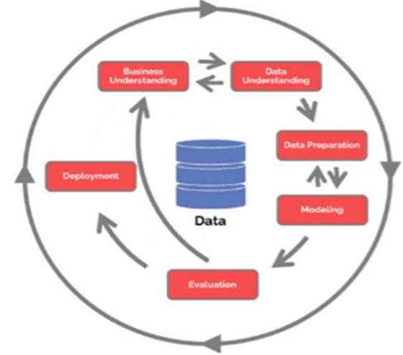
Methodology CRISP-DM
Cross Industry Standard Process for Data Mining is iterative and allows you to go back to previous stages to fix errors or makes improvements.
CRISP-DM has a strong focus on business goals, which is important for this project since I’m looking to provide recommendations for real-world applications.
It is useful for ensemble models because it provides a structure way to combine the results of multiple models.
It also ensures that the individual models are evaluated and tested properly before there are combined into ensemble model.
It ensure that the individuals models are compatible with each other and that there are trained on similar datasets which helps to maximise the accuracy and performance of the ensemble model.

Slide 11
Methodology
Data Collection: Collected customer reviews data from Kaggle.
Data preprocessing: cleaning, tokenizing and normalization.
Split the data into training and testing sets.
Fine-tune the BERT model on the training set
Fine-tune the RoBERT model on the training set.
Evaluate the performance of the BERT and RoBERTa models on the testing set using accuracy, recall, precision , f1 and confusion matrix.
Combine the BERT and RoBERTa into an ensemble model using ensemble methods such as stacking.
Evaluate the performance of the ensemble model on the testing set using accuracy, recall, precision , f1 and confusion matrix.
Analyse results

Slide 12
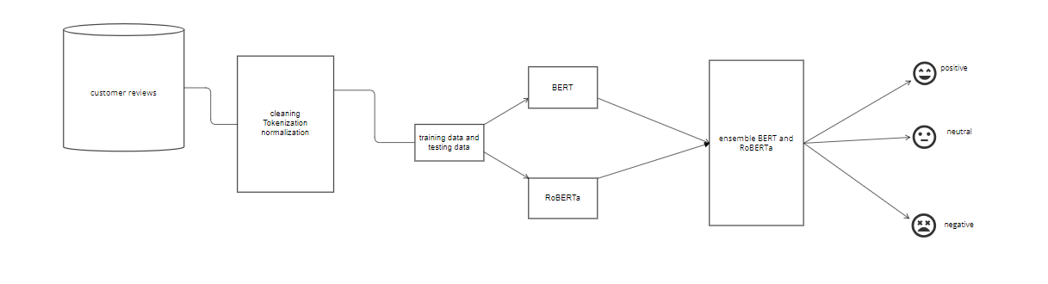
Functionality

Slide 13
Progress Made
Collected e-commerce dataset of customer reviews from Kaggle with 23000 rows and 11 columns
Research available literature review about LLMs
Documented chapter one and two
Imported the required libraries in jupyter notebook
Uploaded customer reviews dataset in jupyter notebook
preprocesses data

Slide 14
References
[1] SCAD Institute of Technology, IEEE Electron Devices Society, and Institute of Electrical and Electronics Engineers, Proceedings of the International Conference on IoT in Social, Mobile, Analytics and Cloud (I-SMAC 2017) : 10-11, February 2017.
[2] S. I. Ross, F. Martinez, S. Houde, M. Muller, and J. D. Weisz, “The Programmer’s Assistant: Conversational Interaction with a Large Language Model for Software Development,” in International Conference on Intelligent User Interfaces, Proceedings IUI, Association for Computing Machinery, Mar. 2023, pp. 491–514. doi: 10.1145/3581641.3584037.
[3] H. Taherdoost and M. Madanchian, “Artificial Intelligence and Sentiment Analysis: A Review in Competitive Research,” Computers, vol. 12, no. 2. MDPI, Feb. 01, 2023. doi: 10.3390/computers12020037.
[4] K. Zvarevashe and O. O. Olugbara, “Recognition of Cross-Language Acoustic Emotional Valence Using Stacked Ensemble Learning,” Algorithms, vol. 13, no. 10, Oct. 2020, doi: 10.3390/A13100246.
[5] K. Zvarevashe and O. Olugbara, “Ensemble learning of hybrid acoustic features for speech emotion recognition,” Algorithms, vol. 13, no. 3, Mar. 2020, doi: 10.3390/a13030070.
[6] J. Pebrianto, J. Surya, K. No, and T. Selatan, “SENTIMENT ANALYSIS OF SERVICE PROVIDER ON TWITTER TWEET USING NAIVE BAYES CLASSIFIER WITH PHP,” Jurnal Innovation and Future Technology (IFTECH) P-ISSN, vol. 5, pp. 2656–1719, 2023.
[7] P. Törnberg, “How to use LLMs for Text Analysis,” Jul. 2023, [Online]. Available: http://arxiv.org/abs/2307.13106
[8] J. Zhou, J. Tian, R. Wang, Y. Wu, W. Xiao, and L. He, “SENTIX: A Sentiment-Aware Pre-Trained Model for Cross-Domain Sentiment Analysis,” Online. [Online]. Available: https://github.com/12190143/SentiX.
[9] E. Hosseini-Asl, W. Liu, and C. Xiong, “A Generative Language Model for Few-shot Aspect-Based Sentiment Analysis,” Apr. 2022, [Online]. Available: http://arxiv.org/abs/2204.05356
[10] A. Bello, S. C. Ng, and M. F. Leung, “A BERT Framework to Sentiment Analysis of Tweets,” Sensors, vol. 23, no. 1, Jan. 2023, doi: 10.3390/s23010506.
[11] U. C. Harish and N. M. Dhanya, “Deciphering Voice of t`he Customer using Text Analytics and Sentiment Analysis: An Interpretable Review Rating Prediction using RoBERTa,” International Journal on Recent and Innovation Trends in Computing and Communication, vol. 10, no. 12, pp. 44–50, Dec. 2022, doi: 10.17762/ijritcc.v10i12.5840.
[12] E. Dang, Z. Hu, and T. Li, “Enhancing Collaborative Filtering Recommender with Prompt-Based Sentiment Analysis,” Jul. 2022, [Online]. Available: http://arxiv.org/abs/2207.12883
[13] Mr. L. Kadu, Dr. M. Deshpande, and Dr. V. Pawar, “Survey of Deep Learning Approaches for Twitter Text Classification,” International Journal of Advanced Engineering Research and Science, vol. 9, no. 12, pp. 106–112, 2022, doi: 10.22161/ijaers.912.12.

